Slide 1

Collaboration With Jupyter Notebooks
Data Science Symposium 2022
University of Cincinnati
Center for Business Analytics
Notes:
Good afternoon. So you might be wondering about the image. This is art generated by the DALL-E project on open ai. DALL-E uses natural language descriptions to generate image – can be photo-realistic, painting or emojis. Description was team writing on notebooks on the planet Jupiter.

Slide 2
Collaboration With Jupyter Notebooks
Data Science Symposium 2022
University of Cincinnati
Center for Business Analytics
Art by DALL-E 2 on labs.openai.com

Slide 3

Notes:
I am currently a team lead for Delta Analytics. Delta Analytics manages data for good fellowships for non-profits. Mainly in analytics and data science. Previously, I was with St Elizabeth Healthcare, across the river, as the enterprise data architect.
Most of the fellowships projects have been data science. But the organization's leadership and sponsors area always asking us to help improve the model development and operationalization support. And how to manage the collaboration across our team and their team. How to manage documentation & testing and versioning. And how to present to other areas of the business. Systems that support this are developed by DevOps or MLOps. Even if you are not in an MLOPs role what I'll try to do today is show you how to easily set up a collaborative system.

Slide 4

Dammit Jim, I'm data scientist not an MLOps
Notes:
So, maybe make it easier for Dr. MCcoy

Slide 5
Collaboration is Critical
Studies show only 13% of data science models make it to production (VentureBeat)
Effective collaboration is a major issue:
Disconnect between the data science team and the stakeholders
Difficulty of sharing and communicating within the team
Notes:
Building, testing and deploying models requires a lot of time and effort. And many studies show that the team does not often succeed. VentureBeat reports, only 13% of models make it to production. The failure to realize value from the projects is often due to the disconnect between the data science team and the stakeholders. And the difficulty of sharing and communicating within the team. Team members must develop complex engineering processes, complete detailed research and often work in isolation. Teamwork and collaboration can be one of the most important factors in helping your team succeed.

Slide 6
Collaborative Software for Data Science
Multi-user access
User authentication
Sharing work products
Shared, standard environments
Sharing status and changes
Documenting and presenting results
Notes:
Collaborative software provides your team and stakeholders with a central platform to share knowledge and deliverables to complete projects.
* multi-user access – avoids everyone installing and setting up tools.
* list
As you know, software is not the complete answer to collaboration. A team culture that encourages sharing and transparency is important. But good software can facilitate.

Slide 7
Collaborative Platforms
Binder - based on open source Binder. Uses GitHub and Docker containers. Free service at mybinder.org.
Google Colaboratory - sharing based on Google Drive or GitHub. Free service at colab.research.google.com
Cocalc - commercial service oriented to academics and course management. Cocalc.com
Kraggle - oriented to education, for internal use only (non-commercial). Free service at Kraggle.com
Notes:
There are some good hosted services that provide collaboration. I list the popular ones base on Jupyter technologies emphasizing those with good, free services. Note that some are more oriented to academics and course management.

Slide 8
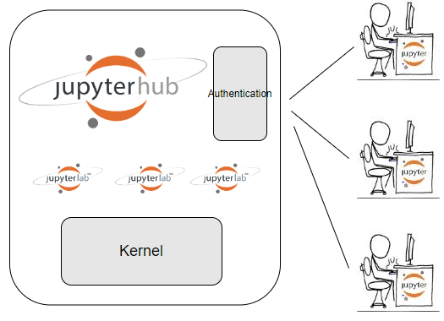
JupyterHub/JupyterLab
Notes:
If you are setting up a cloud or on-premise server for you team, JupyterHub is the most popular solution. JupyterHub is open source with a strong community so you will find lots of help if you have questions.
JupyterHub bundles JupyterLab, which is quite popular.
JupyterHub communicates with the user’s browser and provides a number user authentication implementations. The hub spawns single user servers for notebooks and JupyterLab. And it supports the iPython kernel for notebook functions.

Slide 9
Installing JupyterHub
JupyterHub docs: Installation : JupyterHub
The Littlest Jupyterhub
JupyterHub can be installed on a Linux/Unix server or virtual machine
Notes:
JupyterHub can be installed on a Linux/Unix server or virtual machine.
For instructions on setting up aserver see JupyterHub docs.
There is also a derivative of JupyterHub for a small system with simplified setup on Ubuntu. The Littlest Jupyterhub https://tljh.jupyter.org/
It is a simplified install on Ubuntu.

Slide 10
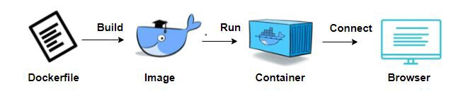
Installing JupyterHub
Rather than spinning up an entire virtual machine, Docker containers are small, fast, and portable.
Notes:
Container technologies have a number of advantages over VM. Container virtualization is simpler than virtual machines (doesn't simulate all hardware and control multiple OS's) Containers are easy to configure and deploy. They have a smaller footprint. And easy to extend. Docker is the most popular. You define an image in a Dockerfile, run a build command. You can then start and instance of the image in a container. And then connect to the container with a browser.

Slide 11
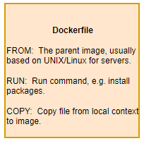
Building a Docker Image
Images are easy to build and extend.
FROM continuumio/miniconda3:latest
RUN conda install -c conda-forge
jupyterhub \
jupyterlab-drawio
COPY jupyterhub_config.py

Slide 12

Docker Hub
Repository service where you can push and pull Docker container Images.
Docker Hub Quickstart Documentation
Photo by Ian Taylor on Unsplash
Notes:
The nice thing about Docker is that there is a repository of images. So you may be able to find and image that has built and configured the tools you need. For example, a node.js or a database like Postgres. If you develop or extend and image you can share it with others by pushing it to Docker Hub.

Slide 13
JupyterHub for Collaboration Image
Anaconda
JupyterHub/JupyterLab
JupyterLab Git
Support for reveal.js
JupyterLab Table of Contents support
Interactive Matplotlib support
Support for adding new users
Hub:
JupyterHub4Collaboration
Details on Medium:
Data Science Team Collaboration with JupyterHub and JupyterLab
Notes:
Today we are going to look at an image built for collaboration with JupyterHub.
Anaconda to support multiple environments and provide popular data science libraries
JupyterHub/JupyterLab
JupyterLab Git to manage updates and sharing on GitHub
Support for reveal.js to produce slide shows
JupyterLab Table of Contents support
Interactive Matplotlib support for presentations
Support for adding new users

Slide 14
Deploy the Image from Docker Hub
Install Docker
Using a terminal or PowerShell pull the image from DockerHub and run the image in a container named j4c using:
Connect: http//localhost:8000
docker run -p 8000:8000 -d --name j4c / jeffgunderson/jupyterhub4collaboration

Slide 15
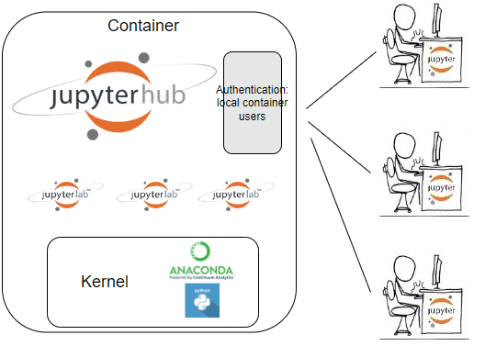
Container
Notes:
So when a user connects the Hub spawns a single user notebook server with JupyterLab. The authentication uses local container users – we'll talk more about that.
One of the reasons we use JupyterHub is to provide a consistent environment for our team and help with reproducibility of results. By default everyone is using the python kernel and packages set up as notebook environment. But there may be a need to set up different environments. As this is based on Anaconda there is support for the Conda package manager. Conda helps you define environments and install packages. For example, you may need a different version of Python or a data science package.

Slide 16
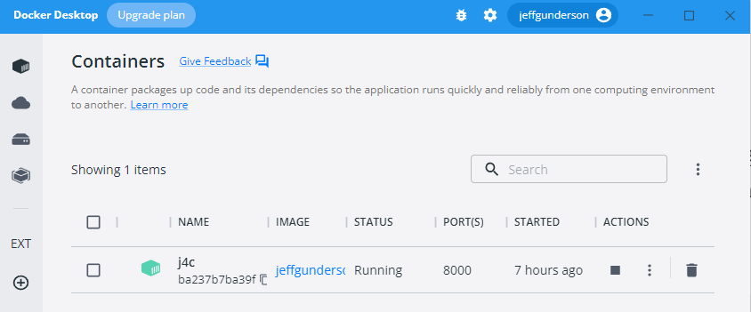
Demo: Docker Desktop
Docker Desktop displays images and containers. Actions are provide to control containers and view logs.

Slide 17
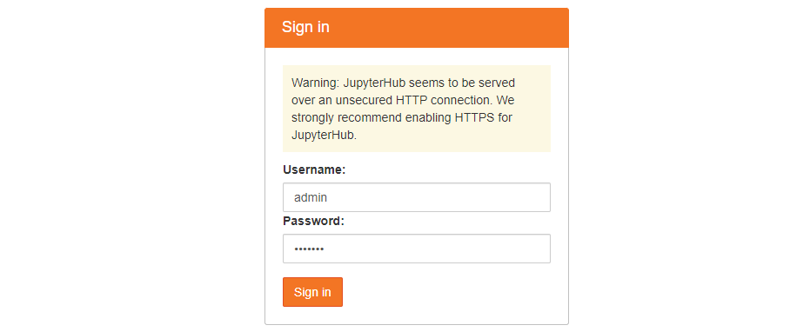
Demo: Connect to Container
Sign on to http://localhost:8000. In the docker file for this image we run commands to define an “admin” user with password “default”.

Slide 18
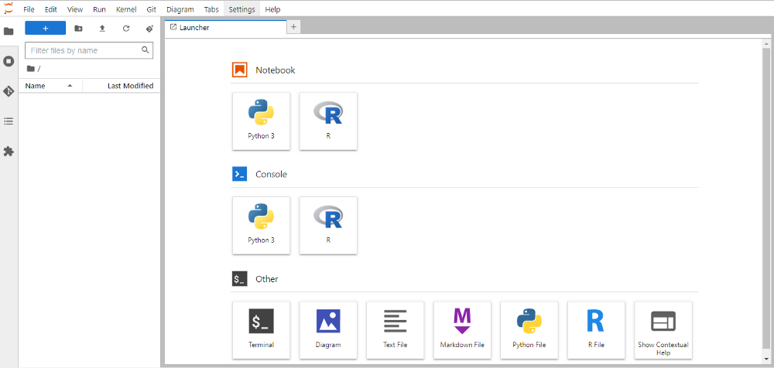
Demo: JupyterLab Launcher
This will present the JupyterLab Launcher where you can launch notebooks, consoles and other applications.

Slide 19
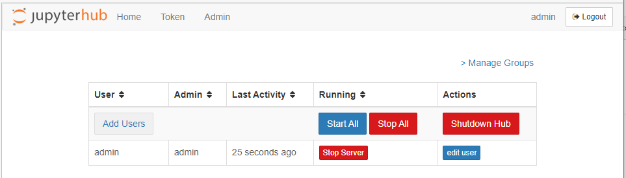
Demo: Add User
JupyterHub supports a number of user authentication methods. We are using the default PAM-based Authenticator, for logging in with container user accounts via a username and password. To add a new user select File > Hub Control Panel > Admin:

Slide 20
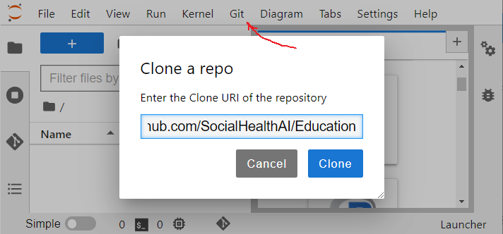
Demo: GitHub
GitHub provides a central repository for your code and allows you to track changes across versions. With the extension you can easily review files and see the changes made by your team.
You can use a public repository to evaluate the extension like SocialHealthAI/Education. Or to set up a repository see: Create a repo — GitHub Docs. For authentication you will need to set up an SSH key or personal access token. GitHub recommends a personal access token as they have finer grain control. See: Personal access tokens. Note that authentication is not necessary if you just want to clone a public repository.

Slide 21
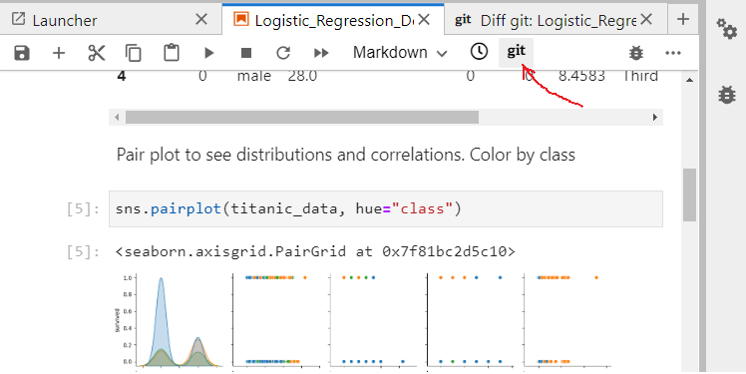
Demo: Git Diff View
To review changes to your notebooks use the git Diff view

Slide 22
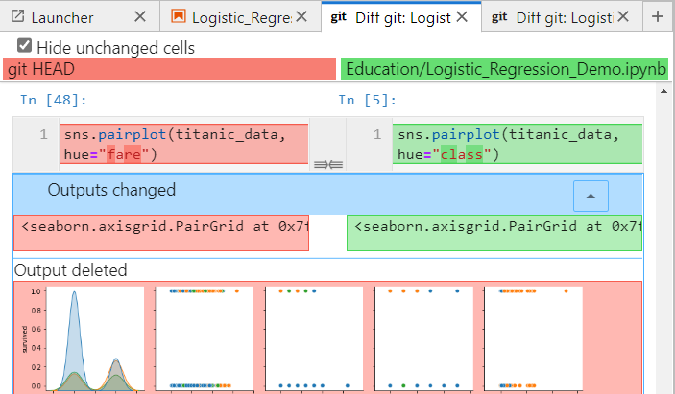
Demo: Git Diff View
The Diff git view shows changes to the code and markdown cells. And it shows outputs deleted and added. If you were to review changes with another diff tool or changes using the GitHub site they would not very useful as notebooks are json files. The GitHub extension for JupyterLab shows changes to the cell contents and the new outputs instead of showing changes to the json file. So you can easily review your updates before committing them to GitHub and share them with the team.

Slide 23
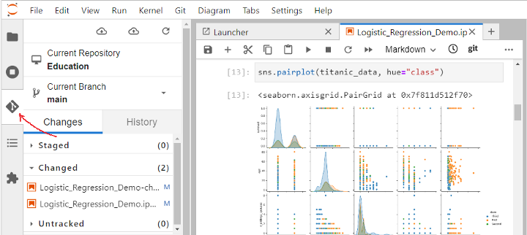
Demo: Git Changes
Selecting the git icon on the left, you can review your staged, changed and untracked files. You can then stage the changed files and commit them.

Slide 24
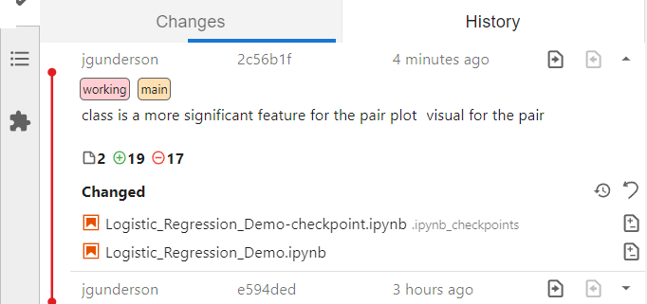
Demo: Git History
If you select the History panel you review the changes in each push to the repository and each branch. You can see the detail and reasons behind the changes made by your team members.

Slide 25
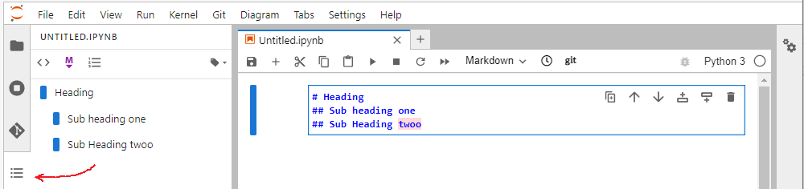
Demo: Table of Contents
JupyterLab Table of Contents is a great way to show the structure of your notebooks and to help navigate. The markdown heading structure is used to present a table of contents. And you can choose to have headings numbered. To navigate to sections in your notebook, select the TOC heading. Note that we installed the JupyterLab Spell Checker and it highlighted an mistake.

Slide 26
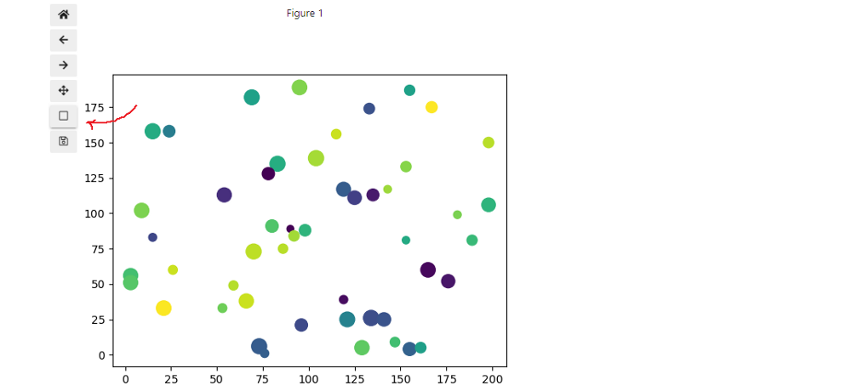
Demo: Interactive Plots
Matplotlib is a popular library for creating static, animated, and interactive visualizations in Python. To help you present Matplotlib charts, the ipympl extension provides interactive features. All you need to do is include the %matplotlib ipympl magic in the notebook. The extension provides selections to pan and zoom into charts

Slide 27
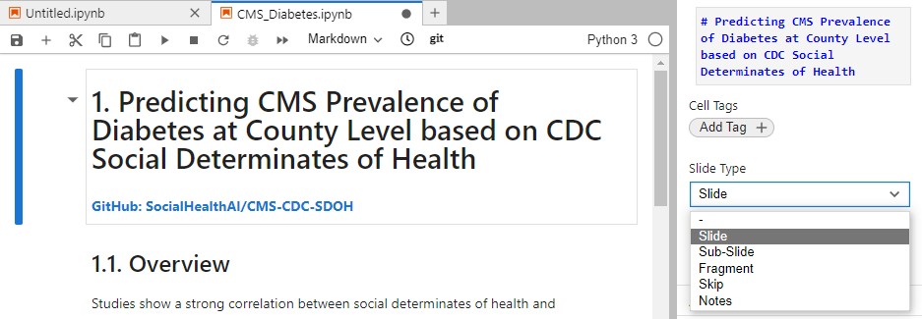
Demo: Presentation Slides
You can create presentation slides from JupyterLab notebooks using the reveal.js extension. Reveal.js is a popular open source HTML presentation package. To create a presentation, open the right sidebar using View > Open Right Sidebar. For each cell, add a slide tag to determine how to present the cell.

Slide 28

Demo: Presentation Slides
Then export the notebook using File > Save and Export Notebook As > Reveal.js Slides. This exports an html file which uses the reveal.js javascript libraries to render slides. To view the file you will need to install the reveal.js libraries . The slides provide selections to show the next, previous or sub-slides. You can also export reveal.js slides to a PDF. See PDF Export | reveal.js

Slide 29

Thank You
Try the image on Docker Hub: JupyterHub4Collaboration
Let me know your ideas, suggestions, issues.
You can also get help at Jupyter Community Forum
If you are in interested in AI for Good:
AI for Good Foundation
Delta Analytics
Jeff Gunderson
Jeff@bidiscover.com
Business Card
Notes:
So if you need a multiple user platform where sharing and reproducability is important, check out JupyterHub.
Try the image on Docker Hub.

